Slide 1
Mariachi An Overview of the History, Genre, and Ensemble

Slide 2
What is Mariachi?
Mariachi originates from rural cultural celebrations of Mexico and dates back to the 18th Century. Mariachi music has become deeply rooted in the United States helping to shape the cultural landscape of the southwestern United States and beyond. It popularity has grown noticeably since the late 1970’s.

Slide 3

Mariachi in Schools
Once school program were limited to borders areas of San Antonio and Tuscon but have spread across the southwest and into other parts of the country, especially since the 1990’s. There are at least 500 schools offering classes along with local and state competitions. In some US schools, mariachi ensembles have replace school bands.

Slide 4
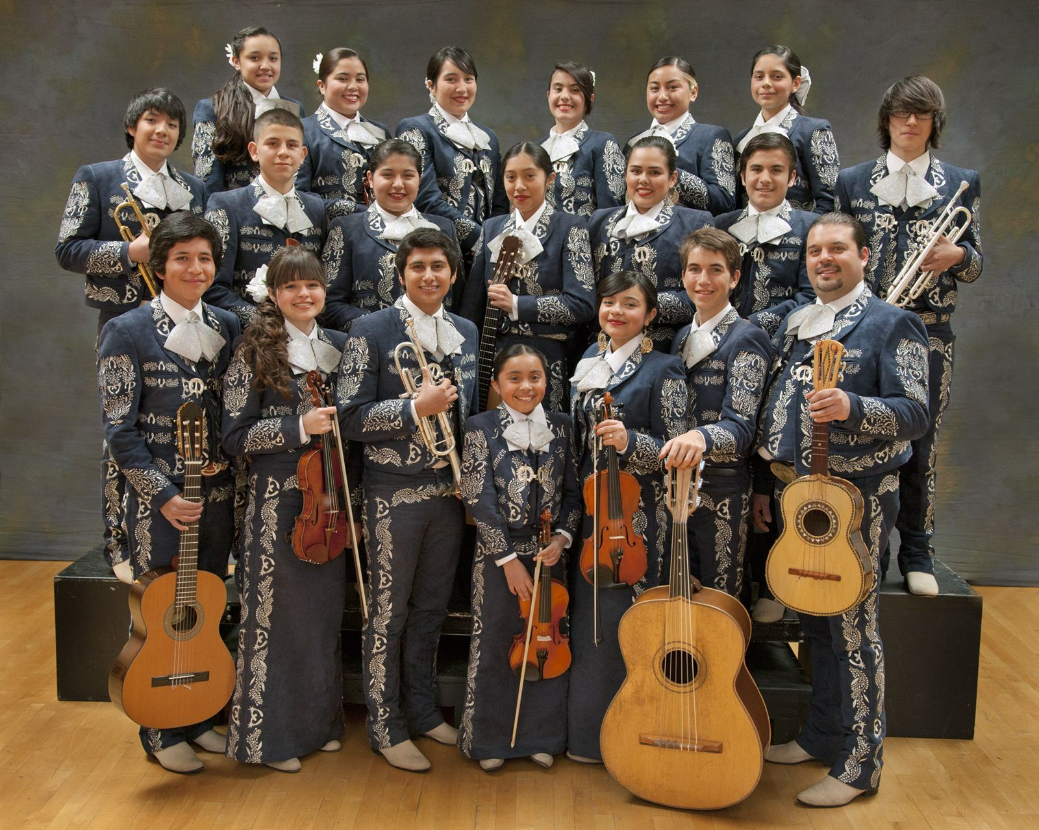
Mariachi Ensembles
The size of a mariachi group varies depending on the availability of musicians. The usual mariachi group today consists of as many as 8 violins, 2 trumpets, and at least 1 guitar.

Slide 5
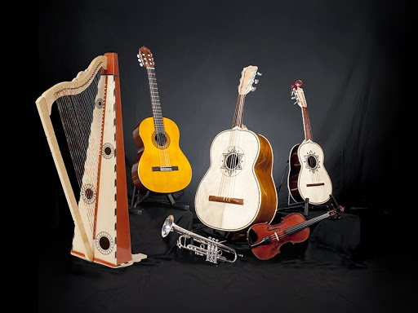
Meet the Instruments

Slide 6
Guitarrón
The Guitarrón is a large bass guitar. Guitarrón translates to large guitar – the suffix means big or large. It has 6 strings. Three are nylon wound with a nylon monofilament core or nylon fibers. The other three strings are steel, bronze, or copper wound with a single steel string core.

Slide 7
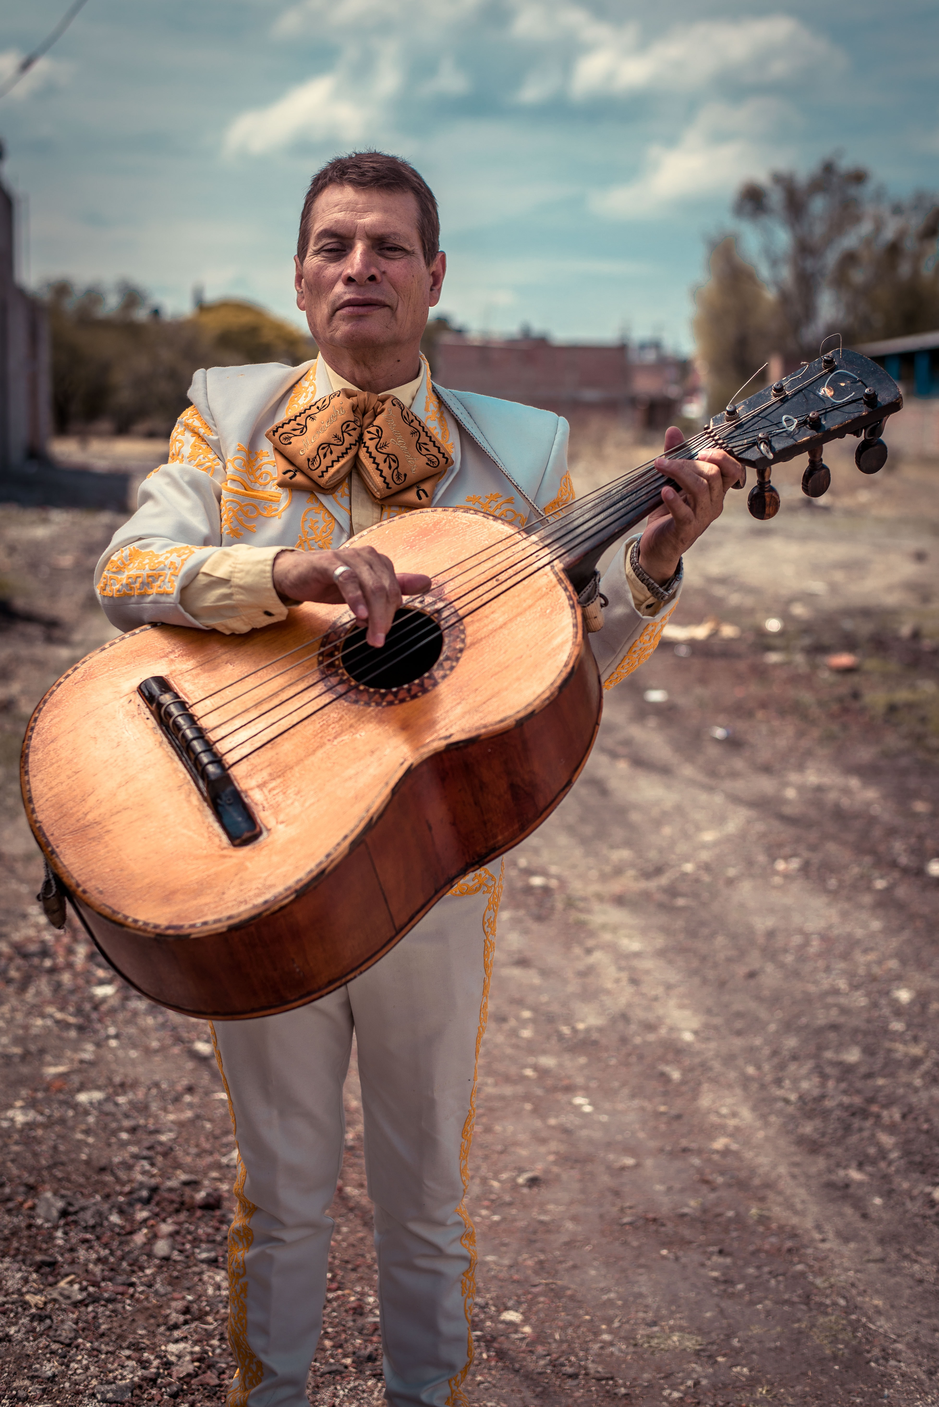
The role of the Guitarrón functions as the backbone of the mariachi ensemble. It provides the bass line, the primary rhythmic pulse, and primary musical guide. Paired with the guitar and vihuelas, together commonly referred to as the rhythm section or las armonías. It is interesting to note that the Guitarrón eventually replaced the harp as a bass instrument. The Guitarrón was the instrument preferred by the mariachi musicians in central Jalisco.

Slide 8
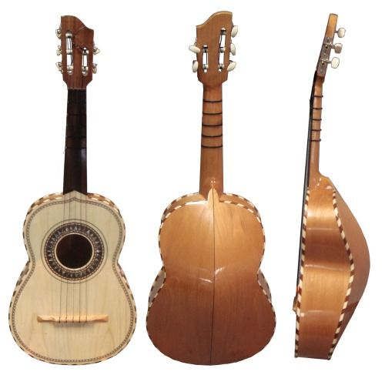
VIHUELA MEXICANA
The VIHUELA MEXICANA is a traditional instrument used in Mariachi music. It is physically similar to the Guitarrón but on a smaller scale. The sound produced from this musical instrument is that of a tenor guitar. The body or the sound box is much smaller than a guitar, and the vihuela has a convex back.

Slide 9
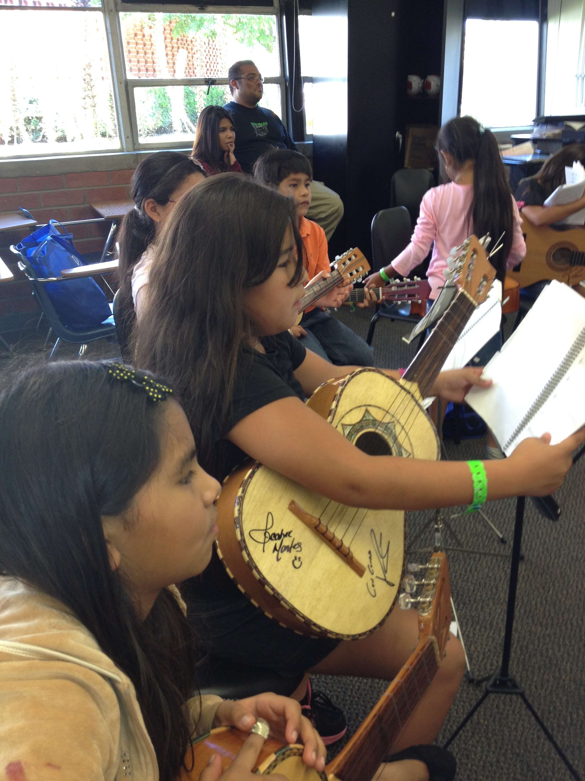
Melodic lines are not usually played with the Vihuela Mexicana. It is considered a stringed chordal instrument. The role of the Vihuela Mexicana functions as the secondary rhythmic support instrument to the Guitarrón. It provides the rhythmic, syncopated pulse and musical guide along with the Guitarrón and the guitar. The Vihuela Mexicana provides and maintains the tonality for the ensemble, which is the pitch preference. The Guitarrón, Vihuela Mexicana and Guitar together are commonly referred to as the rhythm section or las armonías).

Slide 10
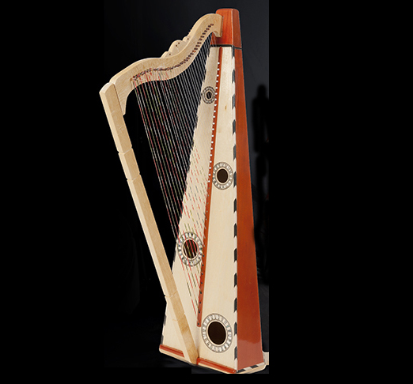
Mariachi Harp
When playing the mariachi harp, the left-hand plays the bass line, and the right-hand performs the melodic line. Together, the harpist could play the bass line and the melodic line without any other melodic instrument accompaniment. The vihuela was used to accompany the harp and function as the rhythmic pulse. The harp is a large instrument and played while the harpist is standing.

Slide 11
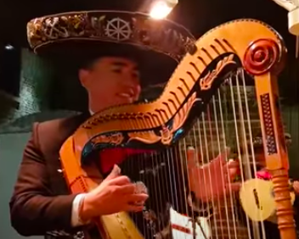
The role of the Harp in today’s mariachi ensemble is to play the bass line along with the Guitarrón. It can also provide a melody line but generally not as frequently as it was once played in the past. The harpist can even play chords and arpeggios as per the specified musical arrangement.

Slide 12
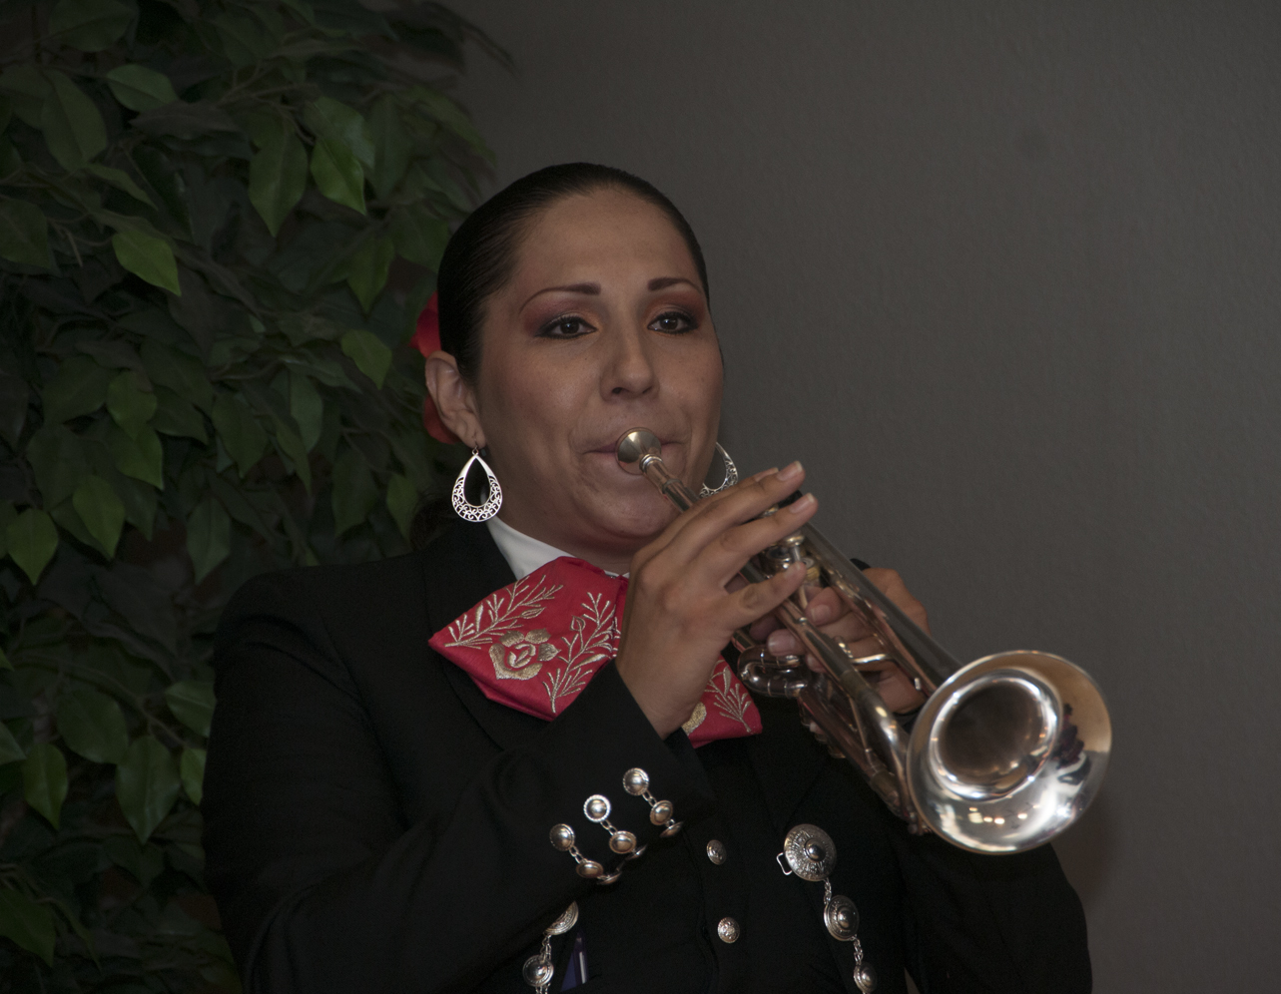
The Trumpet
The role of the trumpet in the mariachi ensemble is to provide melodic lines. Extensive training in breathing and playing technique is crucial in the stylization of this genre of music. Most mariachi ensembles will have at least one trumpet player while large show groups may have up to three trumpet players.

Slide 13
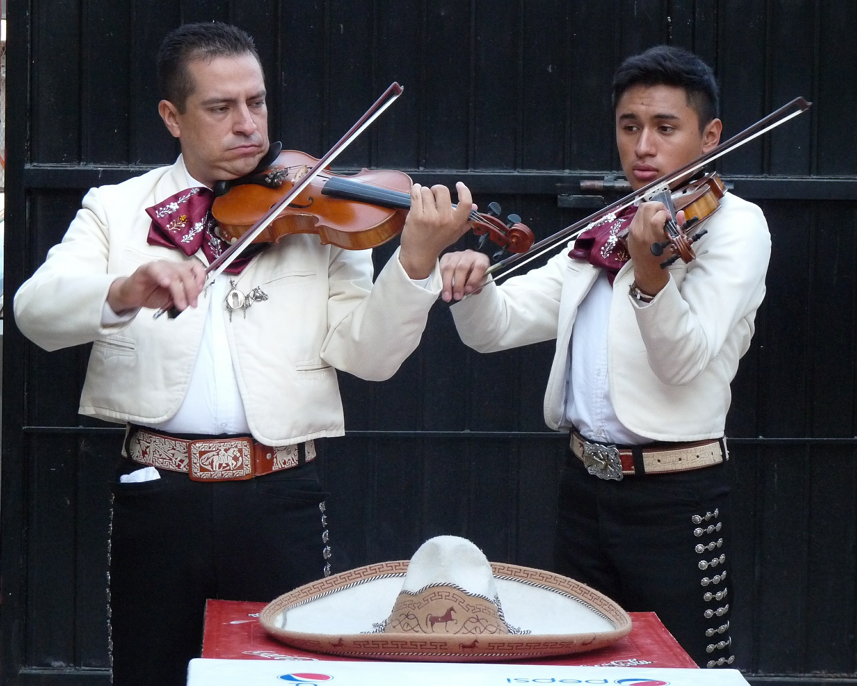
The Violins
The role of the violin in the mariachi ensemble is to provide the melody in either unison or harmony within the violin section. The violin section can play counter melodies to the trumpets. The use of grace notes is widely used, and the pizzicato technique is common.

Slide 14
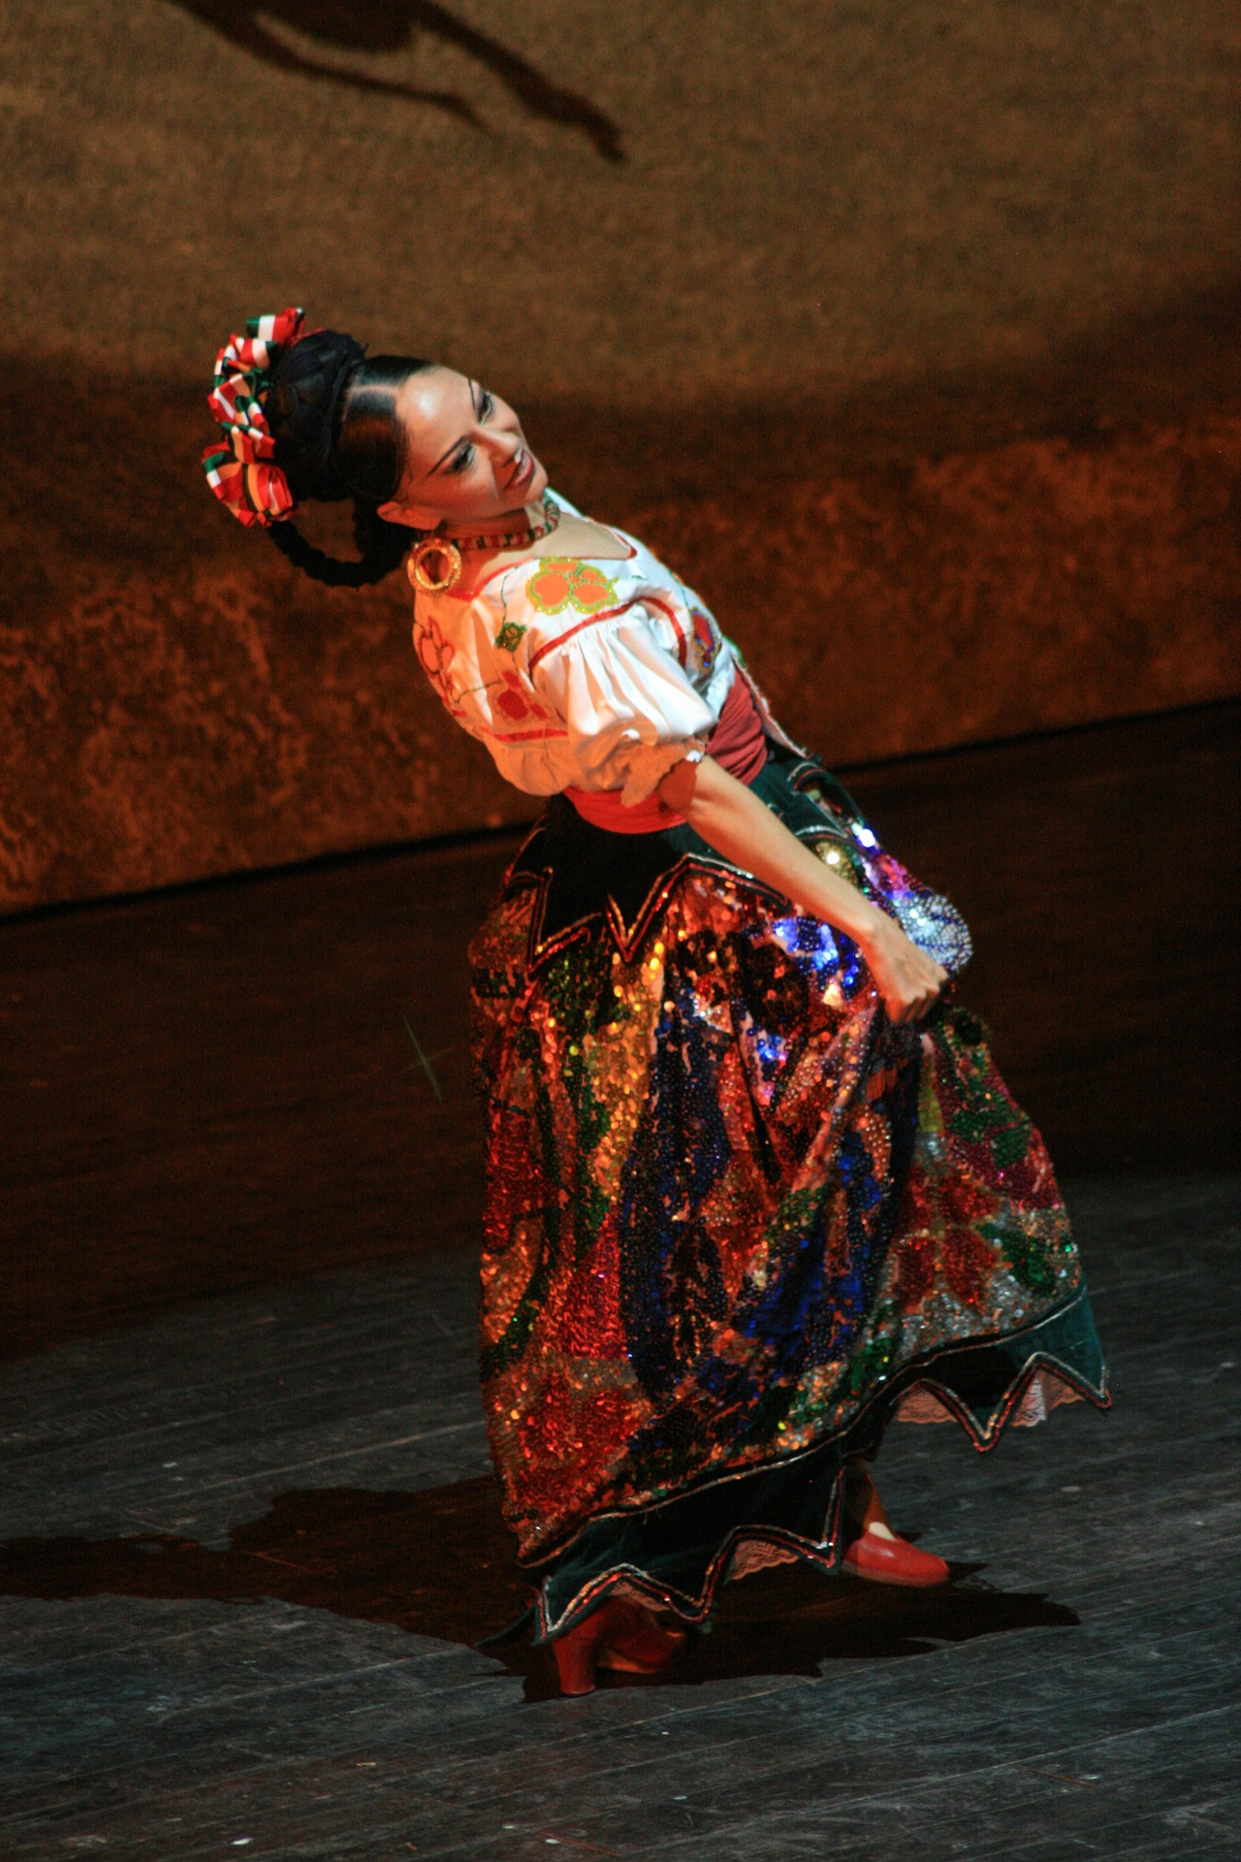
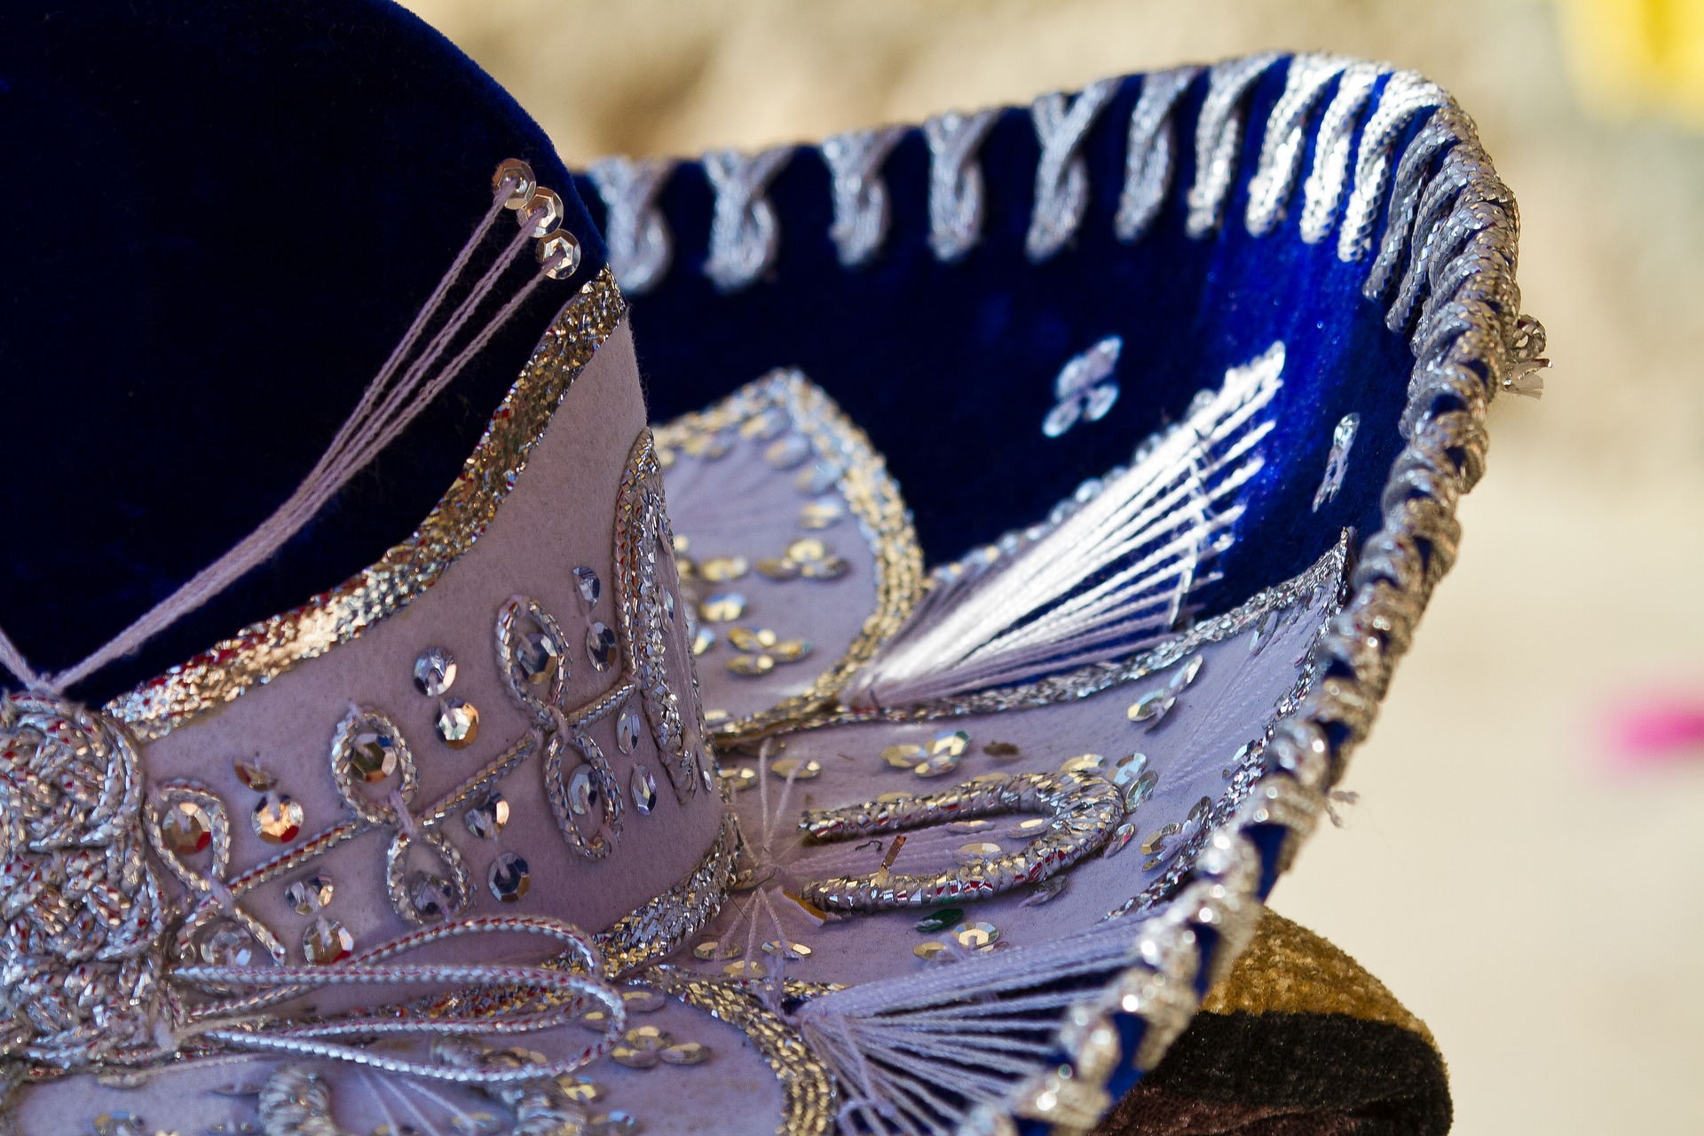
Mariachi is meant to be danced to! The jarabe style of dance and music is a combination of different music and performance. From this style, we get the best-known dance related to mariachi- The Mexican Hat Dance! Based in Guadalajara, it is now considered the official dance of Mexico.

Slide 15
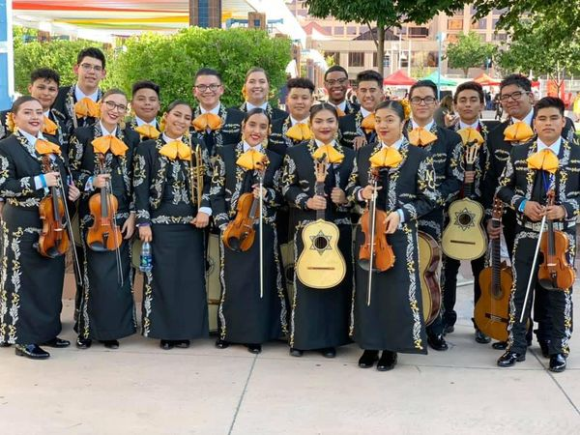
Putting it All Together
Mariachi Chavez presents their first official music video, a stage performance where they interpret the popular son jarocho El Cascabel.

Slide 16
Mariachi On the Big Screen
The concept for Coco is inspired by the Mexican holiday Day of the Dead. The film was scripted by Molina and Matthew Aldrich from a story by Unkrich, Jason Katz, Aldrich and Molina. The film was praised for its animation, voice acting, music, emotional story, and respect for Mexican culture.

